Slide 1
COM1013
INTRODUCTION TO COMPUTER SCIENCE
Lecturer: Begüm MUTLU BİLGE, PhD
begummutlubilge+com1013@gmail.com (recommended)
bmbilge@ankara.edu.tr

Slide 2
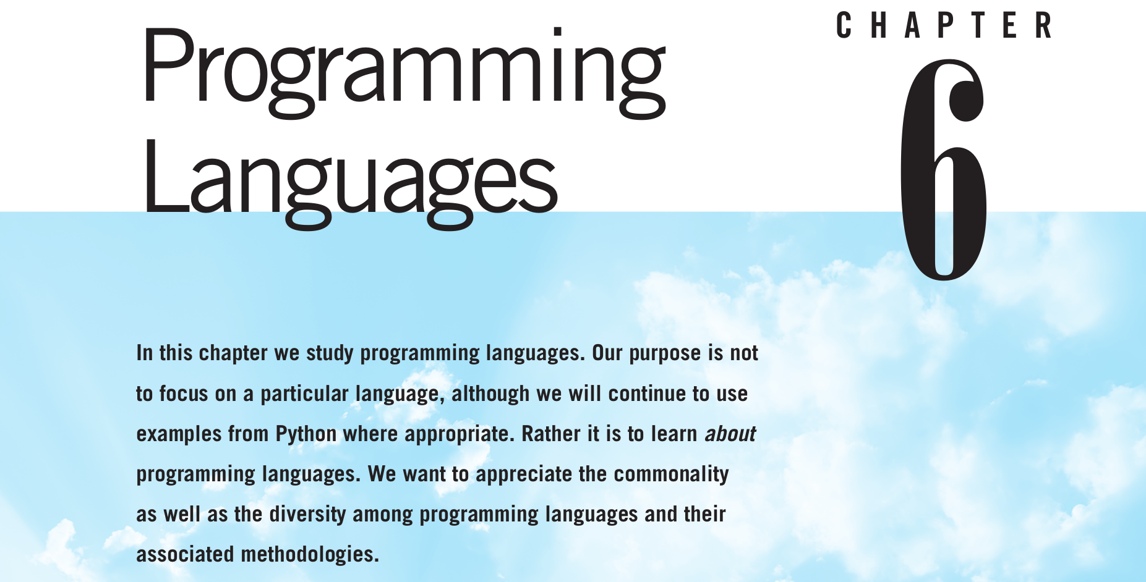
Notes:
The development of complex software systems such as operating systems,
network software, and the vast array of application software available today
would likely be impossible if humans were forced to write programs in machine
language. Dealing with the intricate detail associated with such languages while
trying to organize complex systems would be a taxing experience, to say the least.
Consequently, many programming languages have been developed that allow
algorithms to be expressed in a form that is both palatable to humans and easily
convertible into machine language instructions. Our goal in this chapter is to
explore the sphere of computer science that deals with the design and implemen-
tation of these languages.

Slide 3
Historical Perspective: Early Generations
Writing programs in a machine language is a tedious task
that often leads to errors
In the 1940s, researchers simplified the programming process by developing notational systems by which instructions could be represented in mnemonic rather than numeric form.
For example, the instruction
Move the contents of register 5 to register 6
would be expressed as
4056 (using the machine language),
in a mnemonic system it might appear as
MOV R5, R6
Notes:
Unfortunately, writing programs in a machine language is a tedious task that often leads to errors that must be located and corrected (a process known as debugging) before the job is finished.

Slide 4
Historical Perspective: Early Generations
Once such a mnemonic system was established, programs called ­ assemblers were developed
to convert mnemonic expressions into machine language instructions.
A mnemonic system for representing programs is collectively called an assembly language.
Notes:
Once such a mnemonic system was established, programs called ­ assemblers were developed to convert mnemonic expressions into machine language instructions.
Thus, rather than being forced to develop a program directly in machine language, a human could develop a program in mnemonic form and then have it converted into machine language by means of an assembler.
A mnemonic system for representing programs is collectively called an assembly language.

Slide 5
Historical Perspective: Early Generations
a program written in an assembly language is inherently machine dependent
a program written in assembly language cannot be easily transported to another computer design because it must be rewritten to conform to the new computer’s register configuration and instruction set.
The programmer is still forced to think in terms of the small, incremental steps of the machine’s language.

Slide 6
Historical Perspective: Early Generations
The design process is better suited to the use of high-level primitives,
each representing a concept associated with a major feature of the product.
Once the design is complete, these primitives can be translated to lower-level concepts relating to the details of implementation.

Slide 7
Historical Perspective: Early Generations
Following this philosophy, computer scientists began developing programming languages
that were more conducive to software development than were the low-level assembly languages.
High level & machine independent
The best-known early examples are
FORTRAN (FORmula TRANslator), which was developed for scientific and engineering applications, and
COBOL (COmmon Business-Oriented Language), which was developed by the U.S. Navy for business applications.

Slide 8
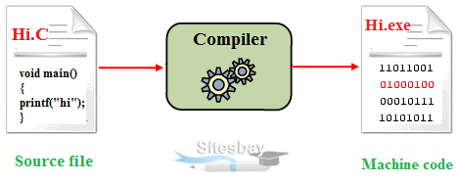
Historical Perspective: Early Generations
Notes:
Once this collection of high-level primitives had been identified, a program, called a translator, was written that translated programs expressed in these high-level primitives into machine-language programs.
Such a translator was similar to the second-generation assemblers, except that it often had to ­compile several machine instructions into short sequences to simulate the activity requested by a single high-level primitive.
Thus, these translation programs were often called compilers.
Figure from: https://www.sitesbay.com/cprogramming/c-compiler

Slide 9
Programming Paradigms
The development of programming languages has developed along different paths
as alternative approaches to the programming process
(called programming paradigms)
  software development paradigm
Notes:
In reality, the development of programming languages has not progressed in a linear manner but has developed along different paths as alternative approaches to the programming process (called programming paradigms) have surfaced and been pursued.

Slide 10
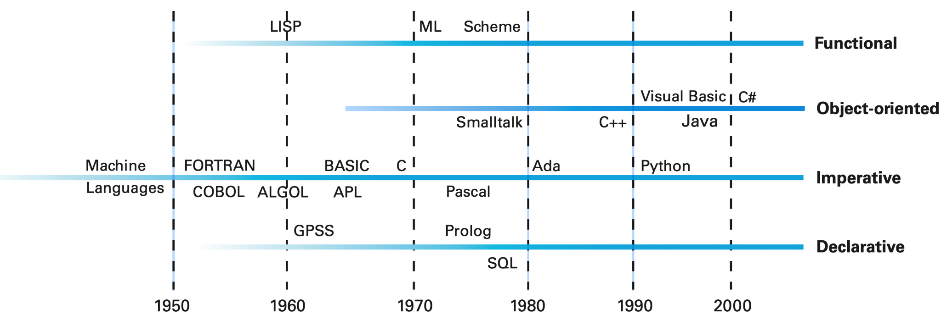
Programming Paradigms
A better representation for the development of programming languages.
Notes:
Consequently, the historical development of programming languages is better represented by a multiple-track diagram as shown in this figure

Slide 11
Programming Paradigms : Imperative (procedural) paradigm
Traditional approach to the programming process.
The development of a sequence of commands that manipulate data to produce the desired result.
Tells us to approach the programming process by
  finding an algorithm to solve the problem at hand and then
  expressing that algorithm as a sequence of commands
Notes:
Imperative (procedural) paradigm
represents the traditional approach to the programming process.
As the name suggests, the imperative paradigm defines the programming process to be the development of a sequence of commands that, when followed, manipulate data to produce the desired result. Thus the imperative paradigm tells us to approach the programming process by finding an algorithm to solve the problem at hand and then expressing that algorithm as a sequence of commands.

Slide 12
Programming Paradigms : Declarative paradigm
Applies a pre-established general-purpose problem-solving algorithm to solve problems
Notes:
declarative paradigm, which asks a programmer to describe the problem to be solved rather than an algorithm to be followed. More precisely, a declarative programming system applies a pre-established general-purpose problem-solving algorithm to solve problems presented to it. In such an environment the task of a programmer becomes that of developing a precise statement of the problem rather than of describing an algorithm for solving the problem.
A major obstacle in developing programming systems based on the declara- tive paradigm is the need for an underlying problem-solving algorithm. For this reason early declarative programming languages tended to be special-purpose in nature, designed for use in particular applications. For example, the declarative approach has been used for many years to simulate a system (political, economic, environmental, and so on) in order to test hypotheses or to obtain predictions. In these settings, the underlying algorithm is essentially the process of simulat- ing the passage of time by repeatedly recomputing values of parameters (gross domestic product, trade deficit, and so on) based on the previously computed values. Thus, implementing a declarative language for such simulations requires that one first implement an algorithm that performs this repetitive function. Then the only task required of a programmer using the system is to describe the situation to be simulated. In this manner, a weather forecaster does not need to develop an algorithm for forecasting the weather but merely describes the current weather status, allowing the underlying simulation algorithm to produce weather predictions for the near future.

Slide 13
Programming Paradigms : Functional paradigm
A program is viewed as an entity that accepts inputs and produces outputs.
Notes:
a program is viewed as an entity that accepts inputs and produces outputs.
ML (Meta Language)
Under this paradigm a program is constructed by connecting smaller predefined program units (predefined functions) so that each unit’s outputs are used as another unit’s inputs in such a way that the desired overall input-to-output relationship is obtained. In short, the programming process under the functional paradigm is that of building functions as nested complexes of simpler functions.

Slide 14
Programming Paradigms : Object oriented paradigm
A software system is viewed as a collection of units, called objects,
  each one is capable of performing the actions that are immediately related to itself as well as requesting actions of other objects.
Together, these objects interact to solve the problem at hand.
Notes:
a software system is viewed as a collection of units, called objects, each of which is capable of performing the actions that are immediately related to itself as well as requesting actions of other objects. Together, these objects interact to solve the problem at hand.
we should note that the methods within an object are essentially small imperative program units. This means that most programming languages based on the object-oriented paradigm contain many of the features found in imperative languages. For instance, the popular object-oriented language C++ was developed by adding object-oriented features to the imperative language known as C. Moreover, since Java and C# are derivatives of C++, they too have inherited this imperative core.

Slide 15
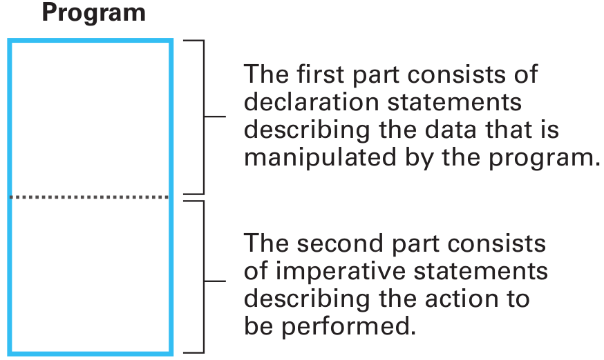
Traditional Programming Concepts
A program consists of a collection of statements that tend to fall into three categories:
declarative statements,
imperative statements, and
comments.
Notes:
Declarative statements define customized terminology that is used later
in the program, such as the names used to reference data items; imperative
statements describe steps in the underlying algorithms; and comments enhance
the readability of a program by explaining its esoteric features in a more human-
compatible form.
Normally, an imperative program (or an imperative program
unit within an object-oriented program) can be thought of as having the struc-
ture depicted in Figure 6.4. It begins with a collection of declarative statements
describing the data to be manipulated by the program. This preliminary material
is followed by imperative statements that describe the algorithm to be executed.
Many languages now allow the declarative and imperative statements to be freely
intermingled, but the conceptual distinction remains. Comment statements are
dispersed as needed to clarify the program.

Slide 16
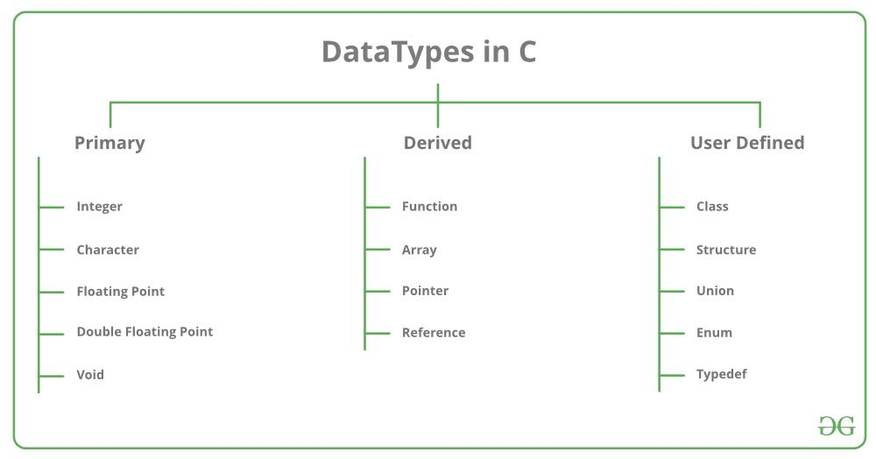
Traditional Programming Concepts
Data types
Notes:
https://www.geeksforgeeks.org/data-types-in-c/
Types
Description
Primitive Data Types Primitive data types are the most basic data types that are used for representing simple values such as integers, float, characters, etc.
User Defined Data Types The user-defined data types are defined by the user himself.
Derived Types The data types that are derived from the primitive or built-in datatypes are referred to as Derived Data Types.

Slide 17
Traditional Programming Concepts
Data Structure
In addition to data type, variables in a program are often associated with data structure, which is the conceptual shape or arrangement of data.

Slide 18
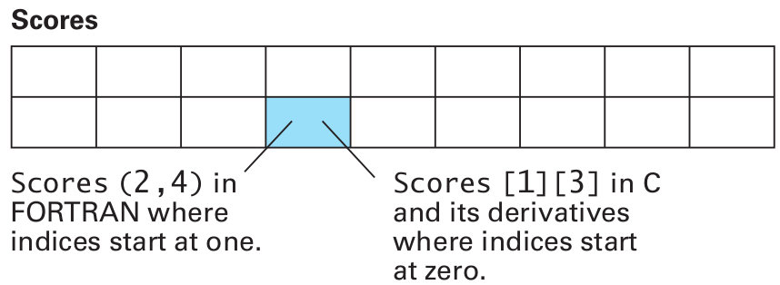
Traditional Programming Concepts
Data Structure
One common data structure is the array, which is a block of elements of the same type such as a one-dimensional list, a two-dimensional table with rows and columns, or tables with higher dimensions.
INTEGER Scores(2,9) int Scores[2][9];

Slide 19
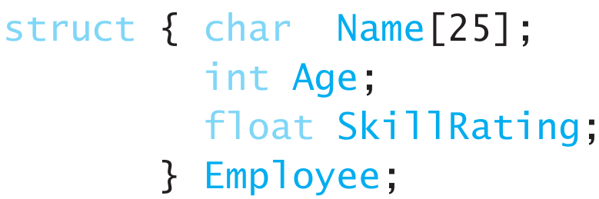
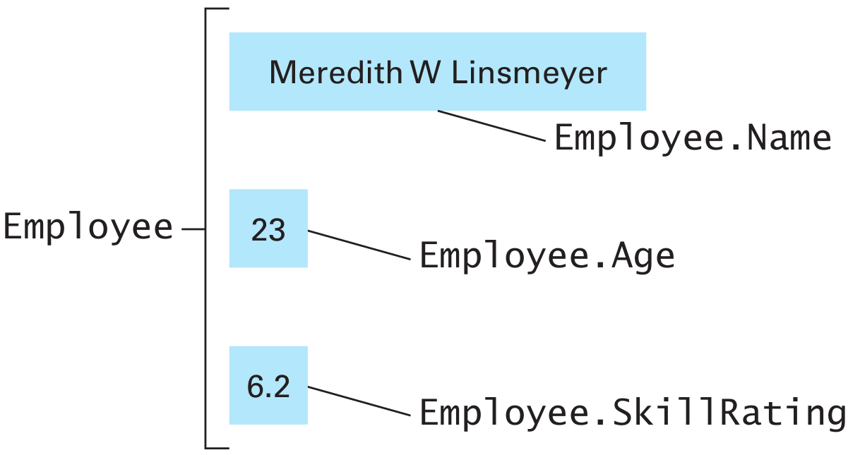
Traditional Programming Concepts
Data Structure
Notes:
In contrast to an array in which all data items are the same type, an ­aggregate
type (also called a structure, a record, or sometimes a heterogeneous array) is a block of data in which different elements can have different types. For
instance, a block of data referring to an employee might consist of an entry
called Name of type character, an entry called Age of type integer, and an entry
called SkillRating of type float. Such an aggregate type would be declared in C
by the statement
struct { char Name[25];
int Age;
float SkillRating;
} Employee;
which says that the variable Employee is to refer to a structure (abbreviated
struct) consisting of three components called Name (a string of 25 characters),
Age, and SkillRating
Once such an aggregate has been declared, a
programmer can use the structure name (Employee) to refer to the entire aggre-
gate or can reference individual fields within the aggregate by means of the
structure name followed by a period and the field name (such as Employee.Age).

Slide 20
Traditional Programming Concepts
Assignment Statements
The most basic imperative statement is the assignment statement
requests that a value be assigned to a variable
Z = X + Y;
Z := X + Y;
Z ← X + Y

Slide 21
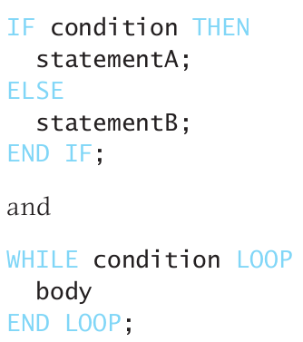
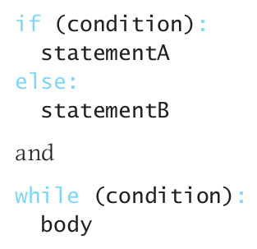
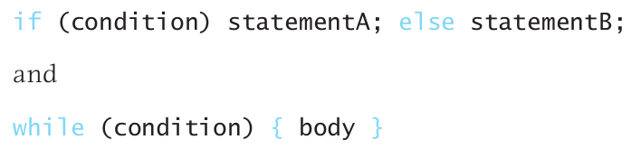
Traditional Programming Concepts
Control Statements
A control statement alters the execution sequence of the program.

Slide 22
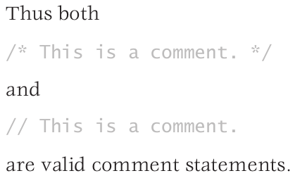
Traditional Programming Concepts
Comments
explanatory statements
These statements are ignored by a translator,
  therefore their presence or absence does not affect the program from a machine’s point of view.

Slide 23
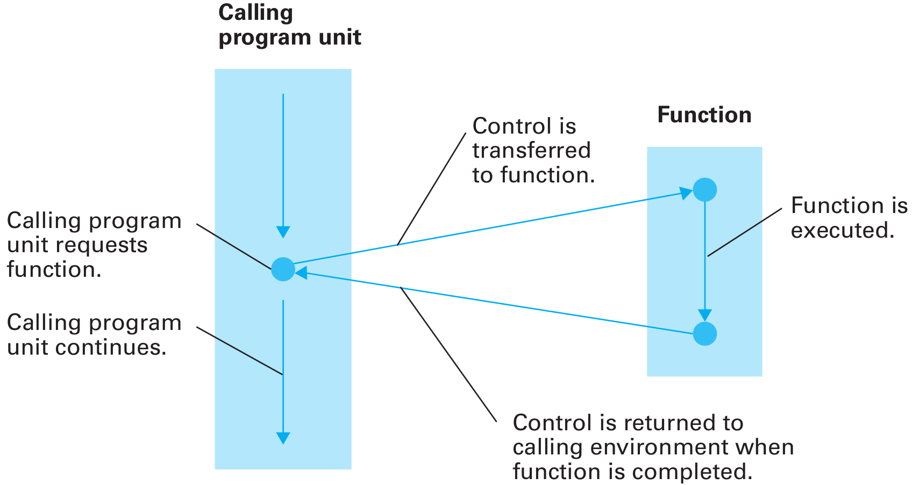
Procedural Units
A function, in its generic sense, is a set of instructions for performing a task that can be used as an abstract tool by other program units.
Notes:
Control is transferred to the function at the time its services are required and then returned to the original program unit after the function has finished (Figure 6.8). The process of transferring control to a function is often referred to as calling or invoking the function.

Slide 24
Procedural Units
Functions are often written using generic terms that are made specific when the function is applied.
Such generic terms within functions are called parameters (formal parameters)
The precise meanings assigned to these formal parameters when the function is applied are called actual parameters.
  The task of transferring data between actual and formal parameters is handled in a variety of ways
    passed by VALUE
    passed by REFERENCE

Slide 25
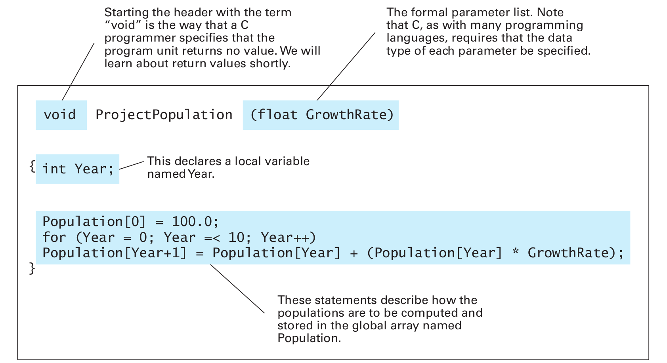
Procedural Units

Slide 26
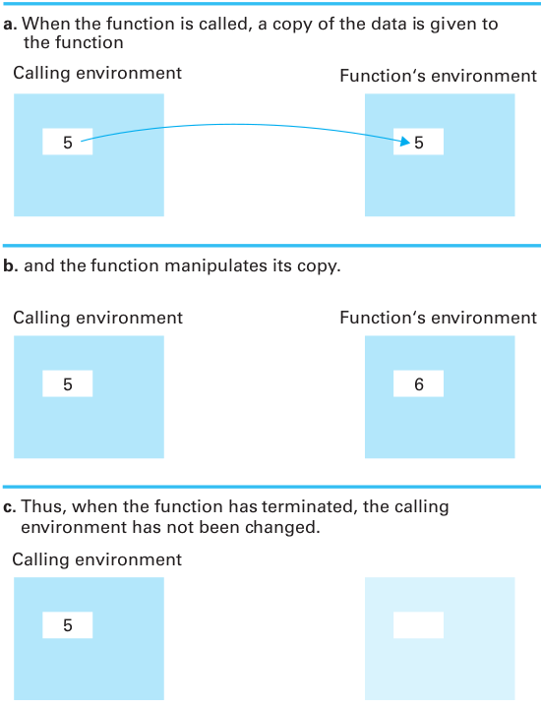
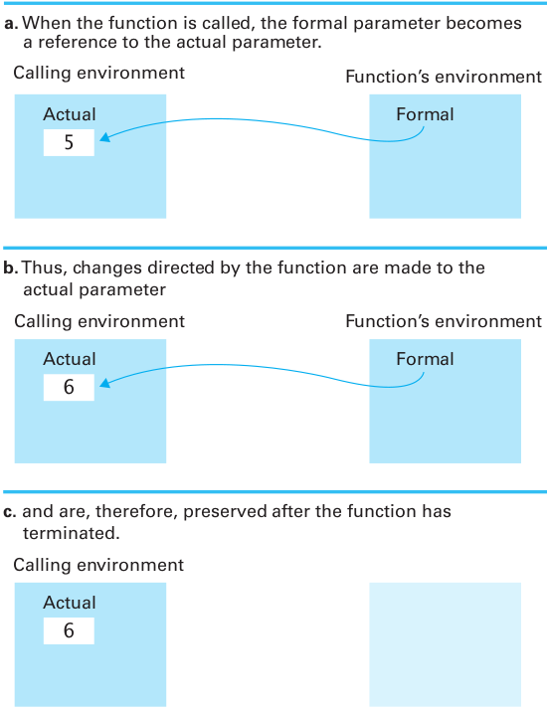
Procedural Units
Notes:
Different programming languages provide different parameter-passing tech-
niques, but in all cases the use of parameters allows a function to be written in a
generic sense and applied to specific data at the appropriate time.

Slide 27
Research Themes
Debugging.
IDEs and Coding Environments.
Probabilistic programming

Slide 28
COM1013
INTRODUCTION TO COMPUTER SCIENCE
Lecturer: Begüm MUTLU BİLGE, PhD
begummutlubilge+com1013@gmail.com (recommended)
bmbilge@ankara.edu.tr

Slide 29
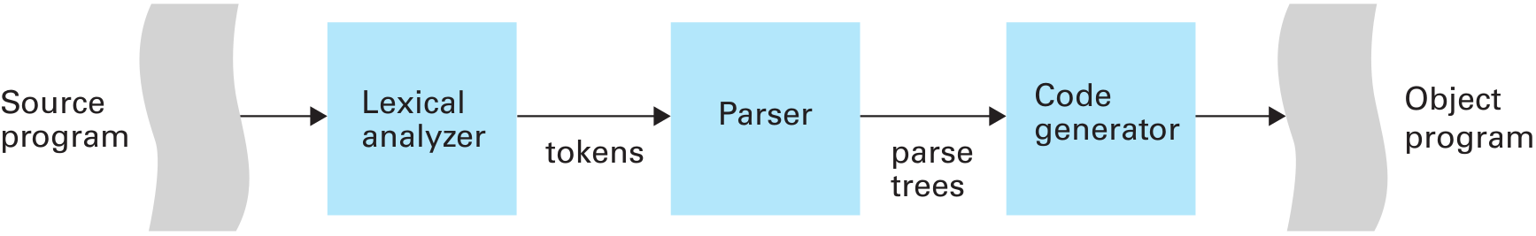
Language Implementation
Translation: The process of converting a program from one language to another
Notes:
In this section we investigate the process of converting a program written in a high-level language into a machine-executable form.
The process of converting a program from one language to another is called translation.
The translation process consists of three activities—lexical analysis, parsing, and code generation

Slide 30
The Translation Process
Lexical analysis is the process of recognizing which strings of symbols from the source program represent a single entity, or token.
Lexical analyzer reads the source program symbol by symbol, identifying which groups of symbols represent tokens, and classifying those tokens according to whether they are numeric values, words, arithmetic operators, and so on.
Notes:
Lexical analysis is the process of recognizing which strings of symbols from
the source program represent a single entity, or token. For example, the three
symbols 153 should not be interpreted as a 1, a 5, and a 3 but should be recog-
nized as representing a single numeric value. Likewise, a word appearing in the
program, although composed of individual symbols, should be interpreted as a
single unit.
Thus the lexical analyzer reads the source program symbol by symbol, iden-
tifying which groups of symbols represent tokens, and classifying those tokens
according to whether they are numeric values, words, arithmetic operators,
and so on. The lexical analyzer encodes each token with its classification and
hands them to the parser. During this process, the lexical analyzer skips over all
­comment statements.
Thus the parser views the program in terms of lexical units (tokens) rather
than individual symbols. It is the parser’s job to group these units into statements.

Slide 31
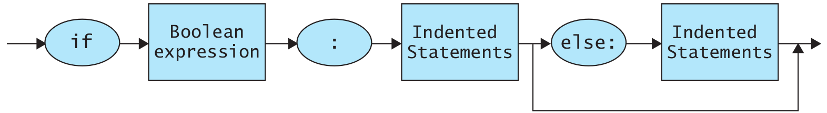
The Translation Process
The parsing process is based on a set of rules that define the syntax of the programming language.
Collectively, these rules are called a grammar.
One way of expressing these rules is by means of syntax diagrams, which are pictorial representations of a language’s grammatical structure.
A syntax diagram of Python's if-else statement
Notes:
The parsing process is based on a set of rules that define the syntax of the programming language.
Collectively, these rules are called a grammar.
One way of expressing these rules is by means of syntax diagrams, which are pictorial representations of a language’s grammatical structure.
Figure 6.14 shows a syntax
diagram of the if-else statement from Python in Chapter 5. This diagram indicates
that an if-else structure begins with the word if, followed by a Boolean expression,
followed by a colon, followed by Indented Statements.
This combination might or might not be followed by the word else, a colon, and Indented ­Statements.

Slide 32
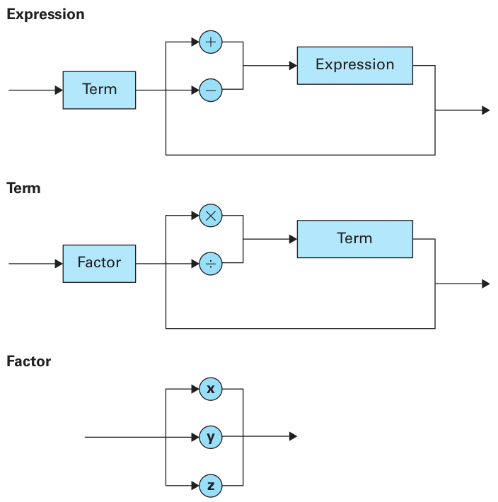
The Translation Process
Syntax diagrams describing the structure of a simple algebraic expression
Notes:
As a more complete example, Figure 6.15 presents a set of syntax diagrams
that describes the syntax of a structure called Expression, which is intended to
be the structure of simple arithmetic expressions. The first diagram describes an
Expression as consisting of a Term that might or might not be followed by either
a + or - symbol followed by another Expression. The second diagram describes
a Term as consisting of either a single Factor or a Factor followed by a * or ,
symbol, followed by another Term. Finally, the last diagram describes a Factor as
one of the symbols x, y, or z.
The manner in which a particular string conforms to a set of syntax dia-
grams can be represented in a pictorial form by a parse tree, as demonstrated in
­Figure 6.16, which presents a parse tree for the string
x + y * z
based on the set of diagrams in Figure 6.15. Note that the tree starts at the top
with the nonterminal Expression and at each level shows how the nonterminals
at that level are decomposed until the symbols in the string itself are obtained. In
particular, the figure shows that (according to the first diagram in Figure 6.15) an
Expression can be decomposed as a Term, followed by the + symbol, followed by
an Expression. In turn, the Term can be decomposed (using the second diagram
in Figure 6.15) as a Factor (which turns out to be the symbol x), and the final
Expression can be decomposed (using the third diagram in Figure 6.15) as a Term
(which turns out to be y * z). The process of parsing a program is essentially that of constructing a parse tree
for the source program. Indeed, a parse tree represents the parser’s interpretation of
the program’s grammatical composition. For this reason the syntax rules describing
a program’s grammatical structure must not allow two distinct parse trees for one
string, since this would lead to ambiguities within the parser. A grammar that does
allow two distinct parse trees for one string is said to be an ambiguous grammar.

Slide 33
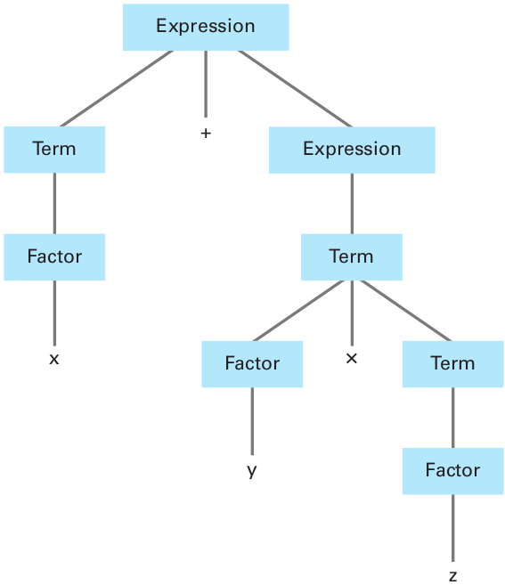
The Translation Process
The parse tree for the string x + y * z based on the syntax diagrams in prev. slide.

Slide 34
The Translation Process
The final activity in the translation process is code generation, which is the process of constructing the machine-language instructions to implement the statements recognized by the parser.
x = y + z
w = x + z
Requires code optimization
Notes:
The final activity in the translation process is code generation, which is
the process of constructing the machine-language instructions to implement the
statements recognized by the parser. This process involves numerous issues, one
being that of producing efficient machine-language versions of programs. For
example, consider the task of translating the two-statement sequence
x = y + z
w = x + z
If these statements are translated as individual statements, each would
require that data be transferred from main memory into the CPU before the
indicated addition takes place. However, efficiency can be gained by recognizing
that once the first statement has been executed, the values of x and z will already
be in the CPU’s general-purpose registers and therefore need not be loaded from
memory before performing the second addition. Implementing insights such as
this is called code optimization and is an important task of the code generator.

Slide 35
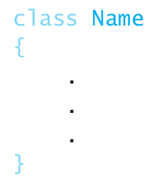
Object-Oriented Programming
object-oriented programming languages provide statements for describing objects and their behavior.
C++, Java, and C#, which are three of the more prominent object-oriented languages used today
In the object-oriented paradigm a template for a collection of objects is called a class.

Slide 36
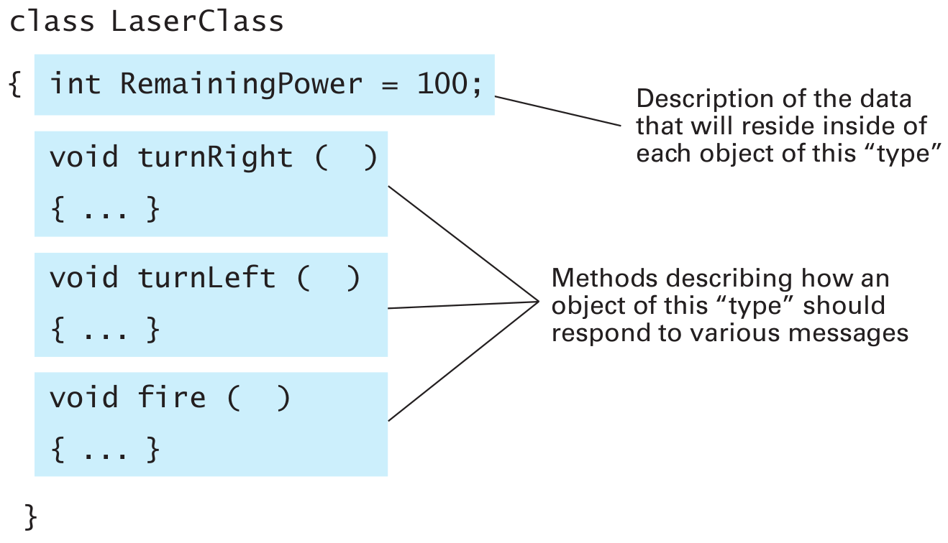
Object-Oriented Programming
Notes:
In particular, a class named LaserClass describing the structure of a laser in
our computer game is outlined in Figure 6.19. The class consists of the declara-
tion of a variable named RemainingPower (of type integer) and three functions
named turnRight, turnLeft, and fire. These functions describe the routines
to be performed to accomplish the corresponding action. Thus any object that
is constructed from this template will have these features: a variable called
RemainingPower and three functions named turnRight, turnLeft, and fire.
A variable that resides within an object, such as RemainingPower, is called
an instance variable and the functions within an object are called methods

Slide 37
Object-Oriented Programming
Once we have described the class LaserClass in our game program, we can declare three variables Laser1, Laser2, and Laser3 to be of “type” ­LaserClass
by a statement of the form
LaserClass Laser1, Laser2, Laser3;
Note that this is the same format as the statement
int x, y, z;

Slide 38
Object-Oriented Programming
Once we have declared the variables Laser1, Laser2, and Laser3 to be of “type” LaserClass, we can assign them values.
In this case the values must be objects that conform to the “type” LaserClass.
LaserClass Laser1, Laser2, Laser3;
not only establishes the variables Laser1, Laser2, and Laser3, but also creates three objects of “type” LaserClass, one as the value of each variable.

Slide 39
Object-Oriented Programming
LaserClass Laser1 = new LaserClass();
declares the variable Laser1 to be of “type” LaserClass and also creates a new object using the LaserClass template and assigns that object as the starting value of Laser1.
Laser1.fire();
Laser2.turnLeft();
Notes:
At this point we should pause to emphasize the distinction between a class
and an object. A class is a template from which objects are constructed. One
class can be used to create numerous objects. We often refer to an object as an
instance of the class from which it was constructed. Thus, in our computer game
Laser1, Laser2, and Laser3 are variables whose values are instances of the class
LaserClass.

Slide 40
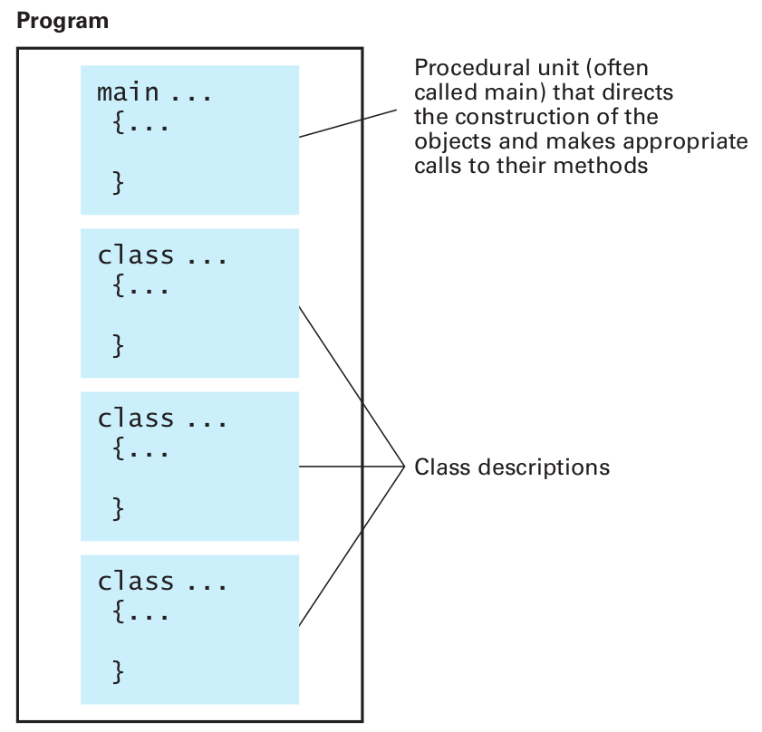
Object-Oriented Programming
The structure of a typical object-oriented program
Notes:
At this stage our meteor game example has given us the background to grasp
the overall structure of a typical object-oriented program (Figure 6.20).
It will
contain a variety of class descriptions similar to Figure 6.19, each describing the
structure of one or more objects used in the program. In addition, the program
will contain an imperative program segment (usually associated with the name
“main”) containing the sequence of steps to be performed initially when the pro-
gram is executed. This segment will contain declaration statements similar to our
laser declarations to establish the objects used in the program as well as impera-
tive statements that call for the execution of methods within those objects.

Slide 41
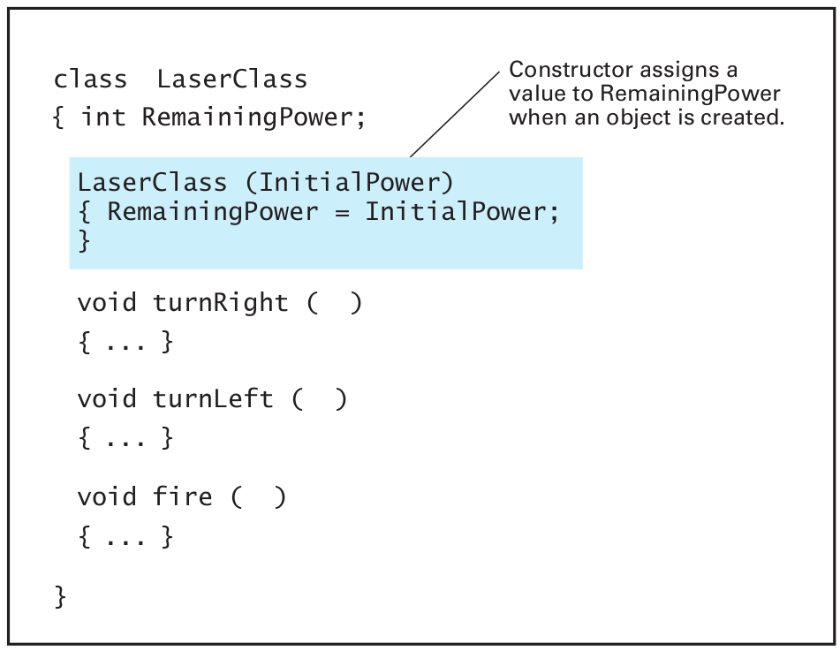
Constructors
Constructors are executed automatically when an object is constructed from the class.
A constructor is identified within a class definition by the fact that it is a method with the same name as the class.
LaserClass Laser1 = new LaserClass(50);
LaserClass Laser2 = new LaserClass(100);
Notes:
Constructors
When an object is constructed, often some customizing activities need to be per-
formed. For example, in our meteor computer game we might want the different
lasers to have different initial power settings, which would mean that the instance
variables named RemainingPower within the various objects should be given dif-
ferent starting values. Such initialization needs are handled by defining special
methods, called constructors, within the appropriate class. Constructors are
executed automatically when an object is constructed from the class. A construc-
tor is identified within a class definition by the fact that it is a method with the
same name as the class.
Figure 6.21 presents an extension of the LaserClass definition originally
shown in Figure 6.19. Note that it contains a constructor in the form of a method
named LaserClass. This method assigns the instance variable R
­ emainingPower
the value it receives as its parameter. Thus, when an object is constructed from
this class, this method will be executed, causing ­RemainingPower to be initialized
at the appropriate setting.
The actual parameters to be used by a constructor are identified in a param-
eter list in the statement causing the creation of the object. Thus, based on the
class definition in Figure 6.21, a C++, programmer would write
LaserClass Laser1(50), Laser2(100);

Slide 42
Object-Oriented Programming
The four basic concepts of OOP are
Inheritance,
Abstraction,
Polymorphism and
Encapsulation

Slide 43
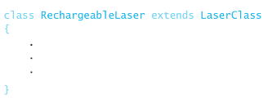
Inheretance
Object-oriented languages allow one class to encompass the properties of another through a technique known as inheritance.
LaserClass Laser1, Laser2;
RechargeableLaser Laser3, Laser4;
Notes:
object-oriented languages allow one class to encompass the properties of another through a technique known as inheritance. As an example, suppose we were using Java to develop our game program. We could first use the class statement described previously to define a class called LaserClass that described those properties that are common to all lasers in the program. Then we could use the statement
class RechargeableLaser extends LaserClass { . . . }
to describe another class called RechargeableLaser. (C++ and C# programmers would merely replace the word extends with a colon.)
Here the extends clause indicates that this class is to inherit the features of the class LaserClass as well as contain those features appearing within the braces. In our case, these braces would contain a new method (perhaps named recharge) that would describe the steps required to reset the instance variable RemainingPower to its original value. Once these classes were defined, we could use the statement
LaserClass Laser1, Laser2; to declare Laser1 and Laser2 to be variables referring to traditional lasers, and use the statement
RechargeableLaser Laser3, Laser4; to declare Laser3 and Laser4 to be variables referring to lasers having the additional properties described in the RechargeableLaser class.

Slide 44
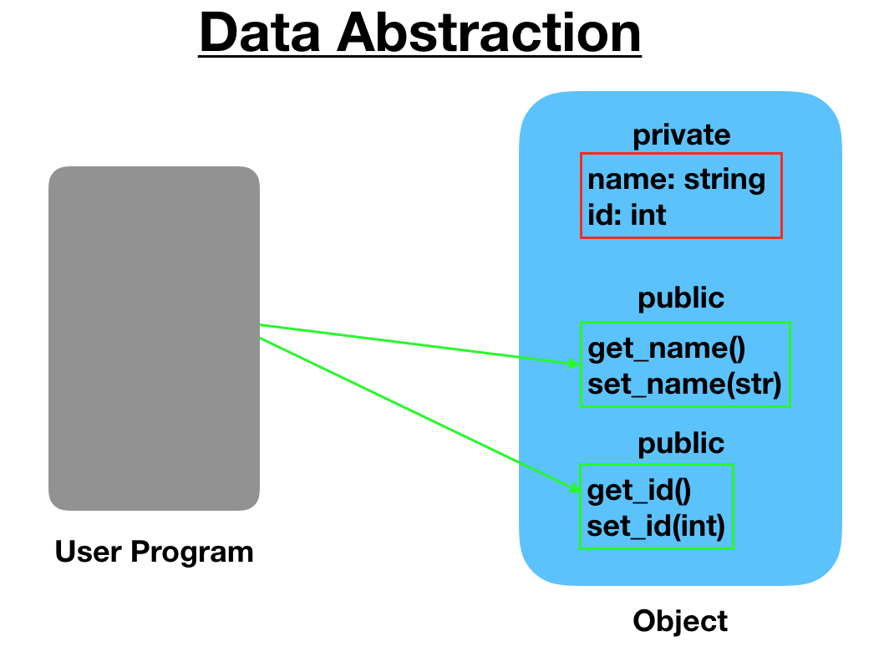
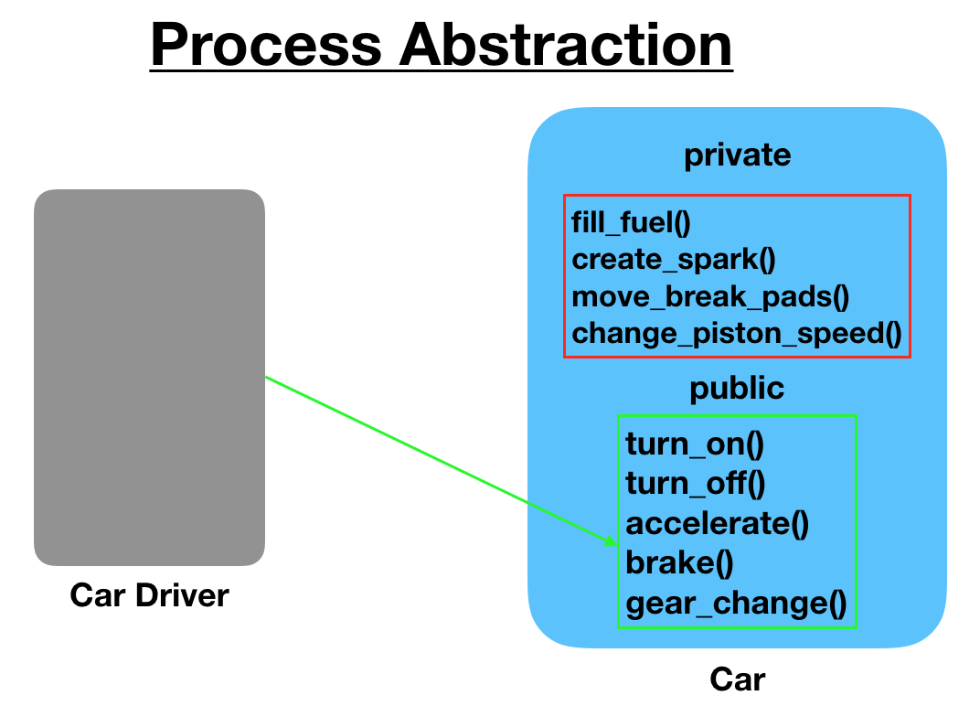
Abstraction
Abstraction is the process of hiding the internal details of an application from the outer world.
Figure from: https://www.digitalocean.com/community/tutorials/what-is-abstraction-in-oops
Notes:
A lot of times programmers often confuse abstraction with encapsulation because in reality the two concepts are quite intertwined and share a relationship between them. Abstraction, as we’ve seen pertains to hiding underlying details and implementation in a program. Encapsulation, on the other hand, describes how abstraction occurs in a program.
Abstraction is a design-level process but encapsulation is an implementation process. Encapsulation tells us how exactly you can implement abstraction in the program. Abstraction pertains to only displaying the essential details to the user whereas encapsulation pertains to typing up all the data members and associated member functions into a single abstracted unit.
Figure from: https://www.digitalocean.com/community/tutorials/what-is-abstraction-in-oops

Slide 45
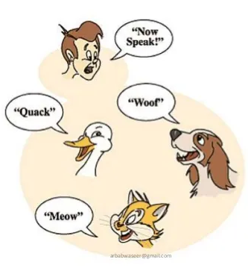
Polymorphism
Notes:
Figure from https://medium.com/@shanikae/polymorphism-explained-simply-7294c8deeef7
Polymorphism is one of the core concepts of object-oriented programming (OOP) and describes situations in which something occurs in several different forms. In computer science, it describes the concept that you can access objects of different types through the same interface. Each type can provide its own independent implementation of this interface.

Slide 46
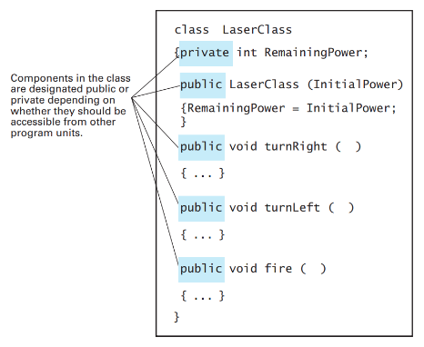
Encapsulation

Slide 47
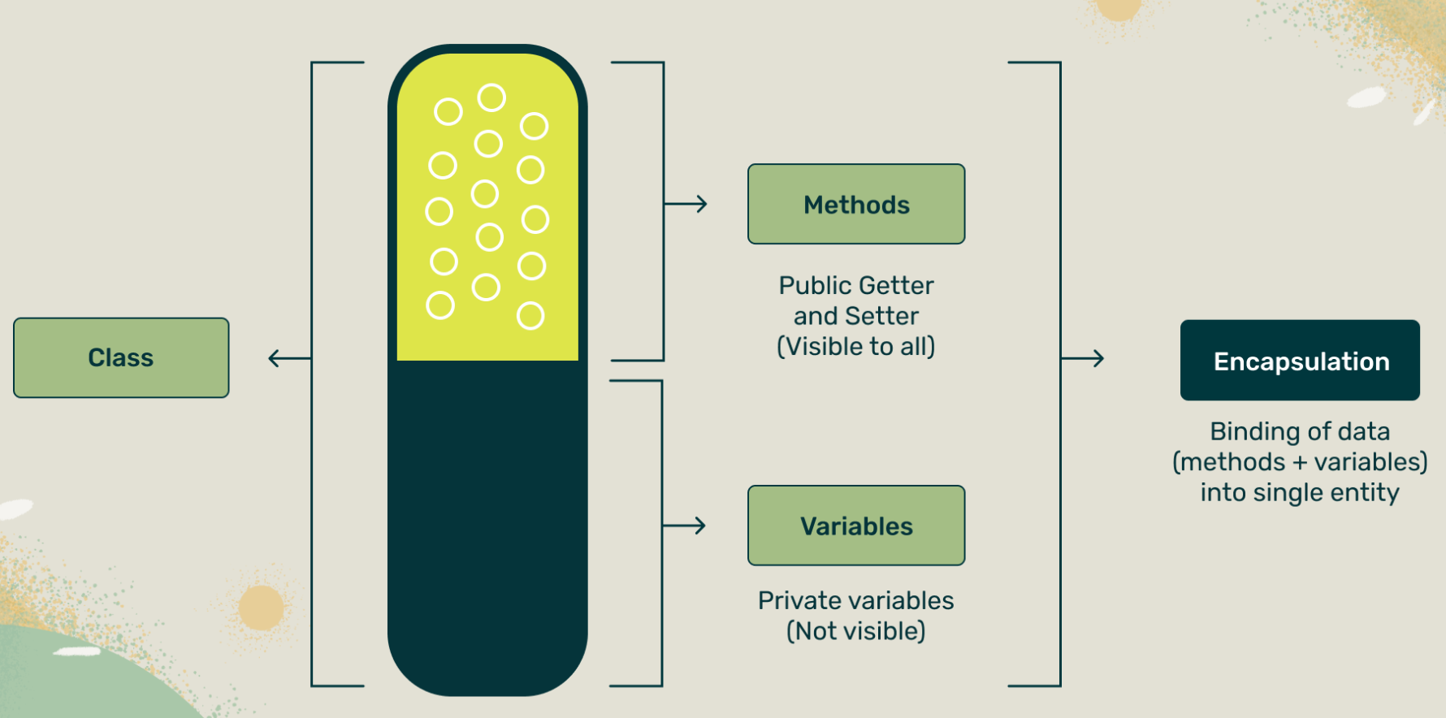
Encapsulation
Figure from https://www.crio.do/blog/encapsulation-in-java/
Notes:
Figure from https://www.crio.do/blog/encapsulation-in-java/

Slide 48
Research Themes
Debugging.
IDEs and Coding Environments.
Probabilistic programming
Design patterns
Concepts and paradigms of object-oriented programming

Slide 49
COM1013
INTRODUCTION TO COMPUTER SCIENCE
Lecturer: Begüm MUTLU BİLGE, PhD
begummutlubilge+com1013@gmail.com (recommended)
bmbilge@ankara.edu.tr

